Slide 1
Aiml project presentation
Diet Recommendation System

Slide 2
index
Problem/Opportunity Domain
Problem/Opportunity Statement
Stakeholders
User Insights
Persona of Stakeholders
How Might We (HMW)
Balanced and Actionable Design
Key Features
Future Step

Slide 3
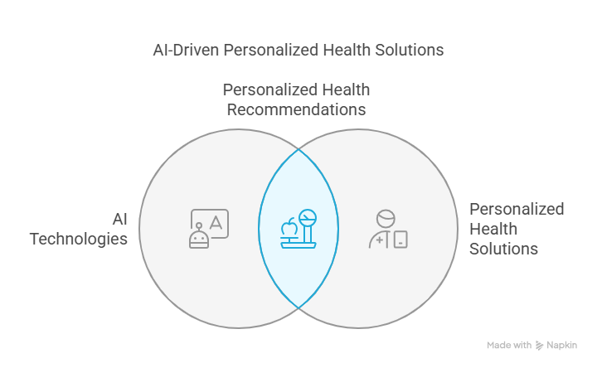
The Problem domain

Slide 4
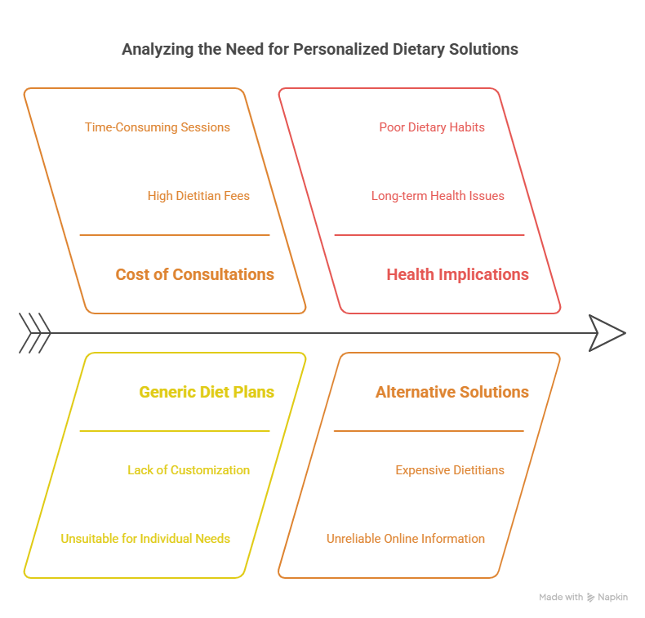
problem statement
Inadequate access to personalized dietary advice contributes to poor health outcomes and diet-related diseases. Traditional methods are often expensive, unscalable, or lack customization. A real-time, automated solution is needed to provide accurate, individualized recommendations.

Slide 5
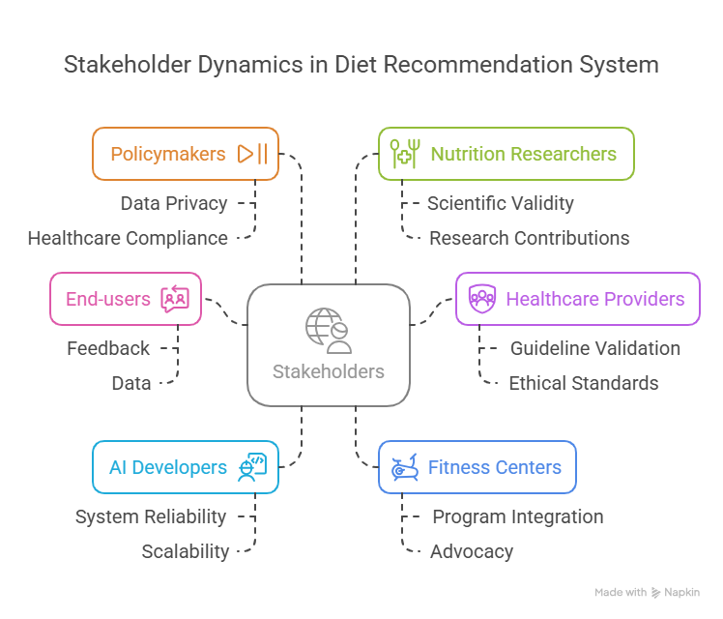
stakeholders
Key Stakeholders: End-users (individuals and patients), Healthcare providers (dietitians, doctors),AI developers and data scientists, Fitness centres and wellness organizations, Policymakers and regulatory bodies, Nutrition researchers.

Slide 6
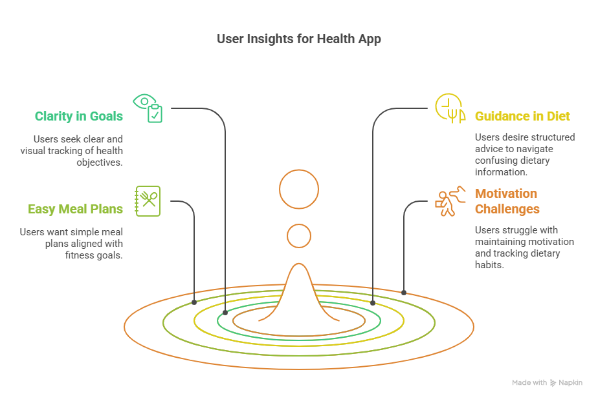
User Insights
Who is your customer?
Who are we empathizing with?

Slide 7
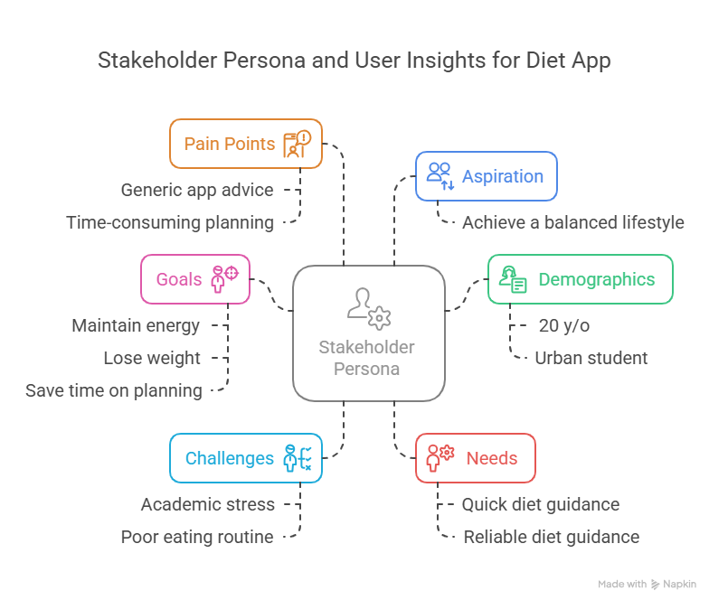
Persona of stakeholders

Slide 8
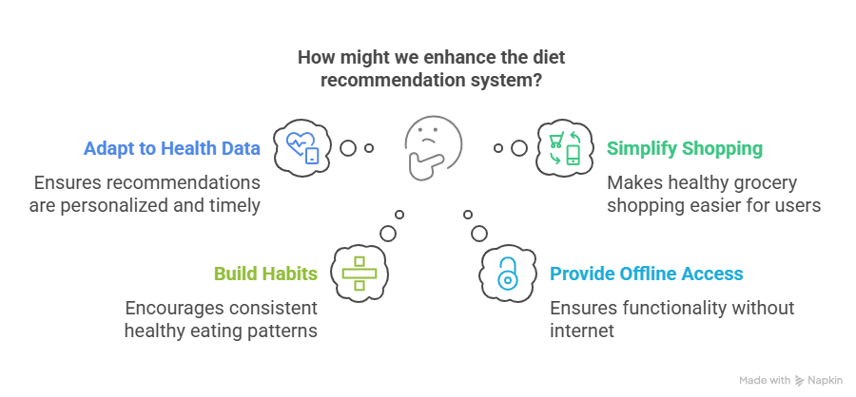
How Might We (HMW)
How might we ensure diet recommendations adapt to real-time health data?
How might we simplify the process of healthy grocery shopping?
How might we help users build consistent healthy eating habits?
How might we provide offline access to essential features?
How might we improve user trust in AI recommendations?

Slide 9
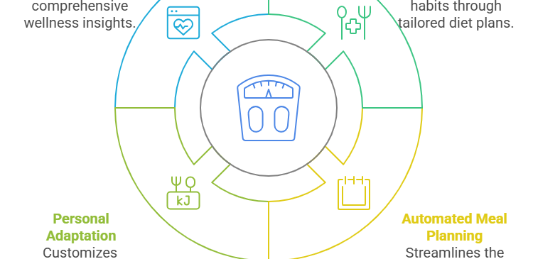
Balanced and Actionable Design

Slide 10
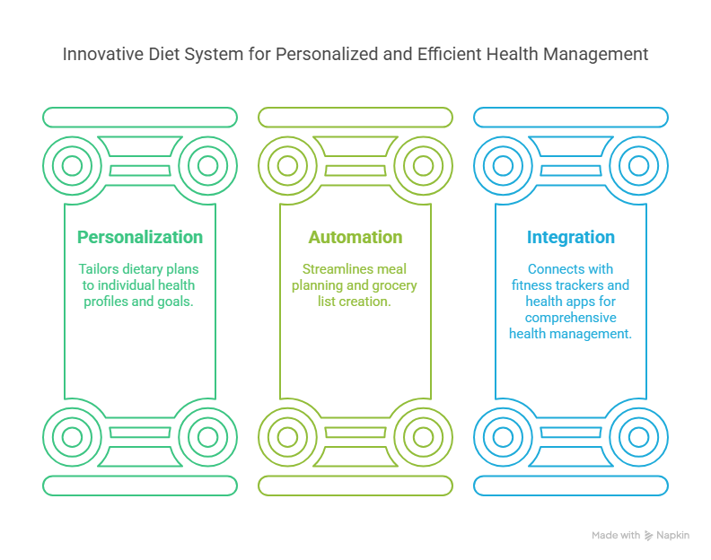
Key Features

Slide 11
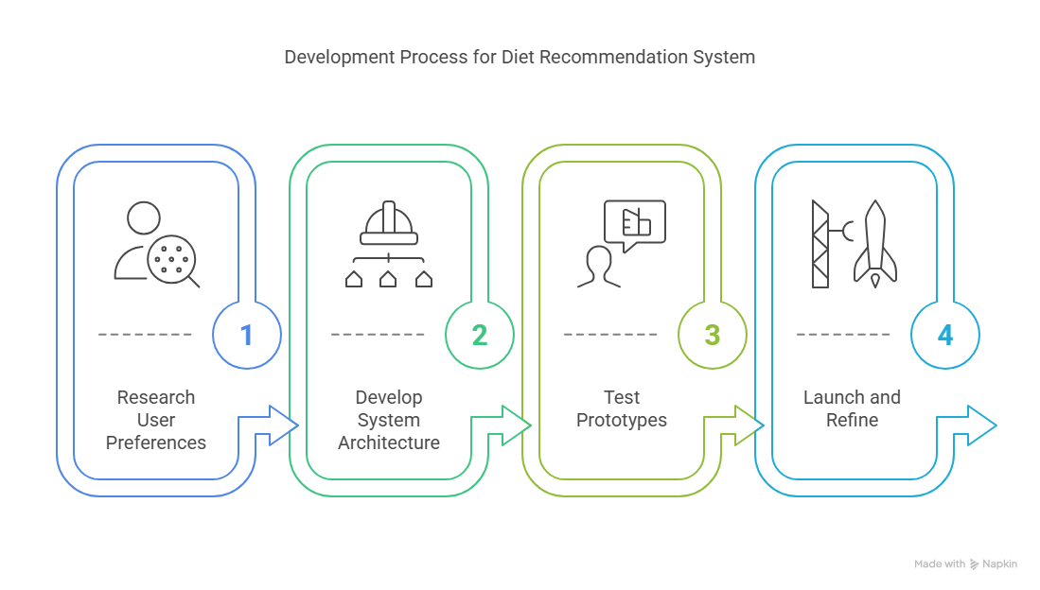
Future plan

Slide 12
Thank you

